Slide 1


Final Year Project Presentation

Slide 2
Automated Attendance Management System
Final Year Project – Progress Presentation
By:
Umair Ali – 19-CE-008
Muhammad Bilal Ahmed – 19-CE-020
Muhammad Faisal – 19-CE-038
Supervisors: Dr. Imran Ashraf , Engr. Ali Raza
Department of Computer Engineering, HITEC University, Taxila

Slide 3
Outline
Introduction
Problem Statement
Objective
Literature Review
Proposed Design Methodology
Hardware & Software Tools
Implementation
Results
Conclusion
References
Department of Computer Engineering, HITEC University, Taxila

Slide 4
Introduction
The Facial Recognition Attendance System with Door Lock is a project that utilizes facial recognition technology.
Facial recognition technology offers automated and accurate identification.
The system offers a best solution to enhance security in various settings.

Slide 5
Problem Statement
Traditional attendance systems require manual recording which is time-consuming and error-prone. Traditional access control systems may rely on physical keys or keycards, which can be lost or stolen.
The Facial Recognition Attendance System with Door Lock overcomes these challenges by using facial recognition technology to automate attendance and provide access control.

Slide 6
Objective
The main objective of this project is to provide a secure, efficient, and automated attendance system and access control to a restricted area.
The system aims to eliminate manual recording and verification of attendance and to provide access only to authorized individuals.

Slide 7
Literature Review
Paper Name | Published Year | Concept
Real-Time Face Recognition | 2018 | In this paper real time face recognition implemented with open source computer vision library.
Comparative analysis of facial recognition models using video for real time attendance monitoring system | 2020 | The main concept behind the automatic attendance system is to apply facial recognition effortlessly compared to other biometric systems.
Attendance Monitoring System based on Artificial Intelligence Facial Recognition Technology | 2021 | This paper therefore presents an attendance monitoring system based on Artificial Intelligence (AI) facial recognition technology uses a deep learning Tensorflow framework to build a face recognition model that can detect images in real time.
Attendance Management System Using Facial Recognition | 2022 | The primary goals of this endeavor are to accurately record attendance and speed up the procedure by finding all faces, Posing and working faces, Encoding faces, finding the person’s name from the encoding.
Table 1

Slide 8
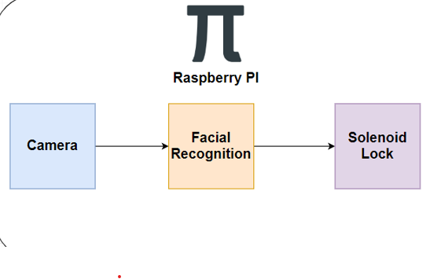





Proposed Design Methodology
Fig. 1: Block diagram

Slide 9
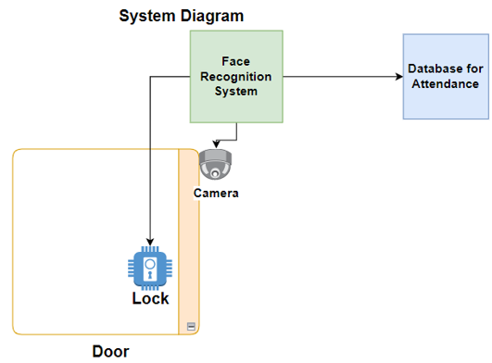
Fig 2: System Diagram

Slide 10
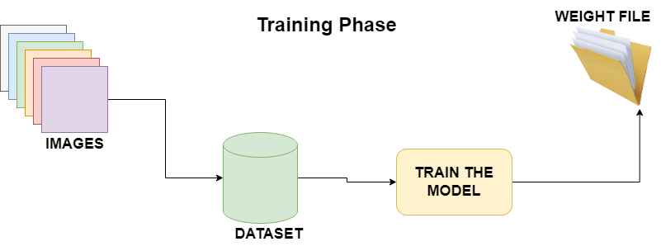
Fig 3: Training Phase

Slide 11
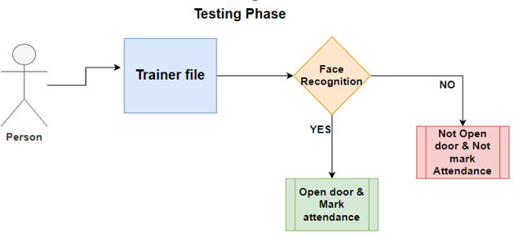
Fig 4: Testing Phase

Slide 12
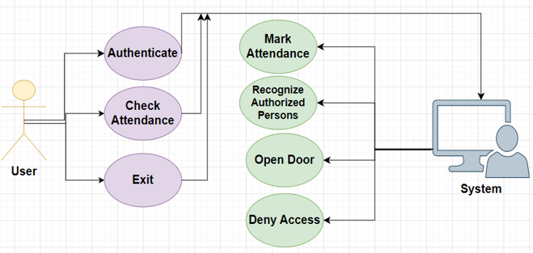
Use Case Diagram
Fig 5: Use Case Diagram

Slide 13
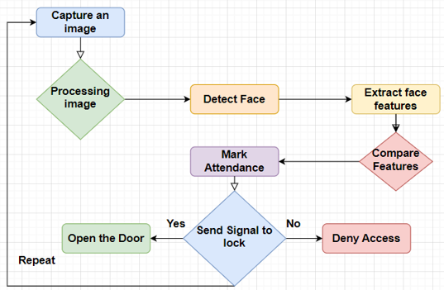
Flow Chart
Fig 6: Flow Chart

Slide 14


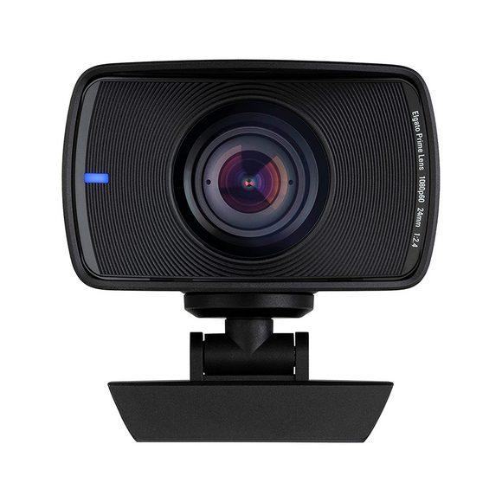
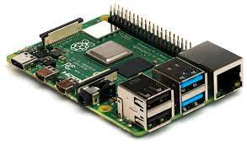
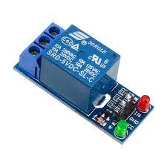
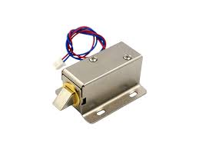
Hardware & Software Tools
In software tools we use Python and Anaconda Spyder.
In hardware tools we use Raspberry Pi, webcam, Solenoid lock, Relay, Connecting wires, LCD, Keyboard and mouse.

Slide 15
Implementation
Hardware Setup: Several hardware components must be connected to the Raspberry Pi 4, including the camera, solenoid lock, relay module, LCD for display and connecting wires etc.
Software Installation: On the Raspberry Pi, install its operating system e.g: Raspbian, necessary Libraries must be installed.

Slide 16
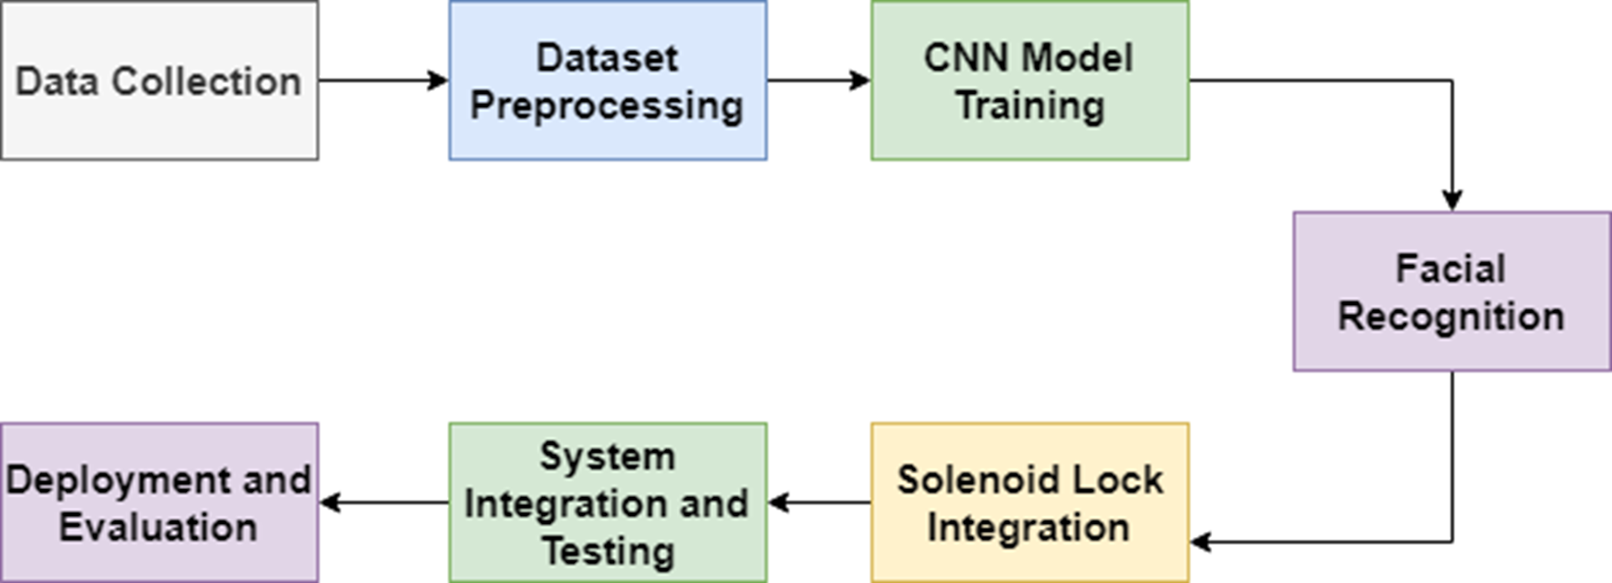
Implementation Steps:
Fig 7: Implementation Steps

Slide 17
Contd:
Data Collection: Gather a diverse dataset of facial images from authorized individuals for training the facial recognition model.
Dataset Preprocessing: Prepare the dataset by resizing and normalizing the images, ensuring consistency in lighting conditions and format.
Model Training: Train a Convolutional Neural Network (CNN) using the preprocessed dataset to learn and identify facial features accurately.
Facial Recognition: Implement real-time facial recognition using the trained CNN model to identify authorized individuals.

Slide 18
Contd:
Solenoid Lock Integration: Integrate a solenoid lock that opens temporarily when an authorized person is recognized, providing secure access control.
System Integration and Testing: Combine the facial recognition and solenoid lock components, test their functionality, and ensure smooth integration.
Deployment and Evaluation: Deploy the system in the desired environment, gather feedback, and evaluate its performance, accuracy, and user satisfaction.

Slide 19
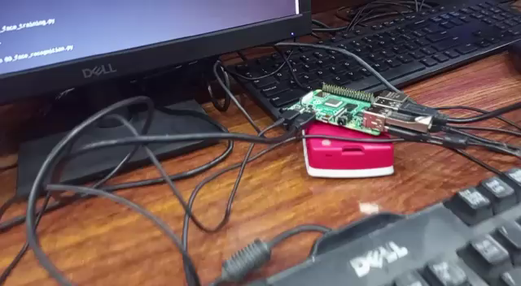
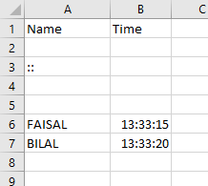
Results
Fig 8: Results

Slide 20
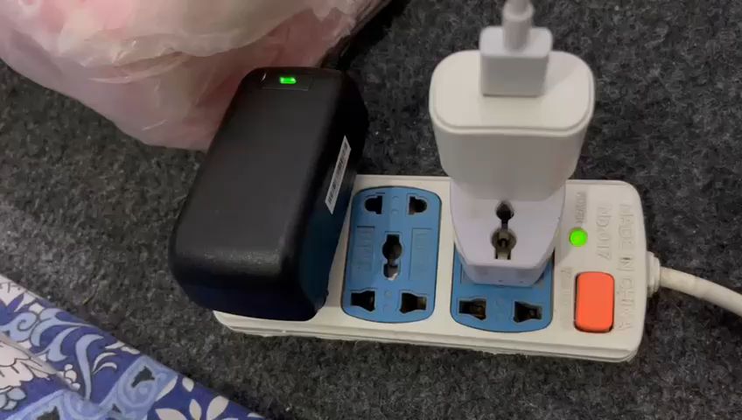
System Video
Fig 9: System Video

Slide 21
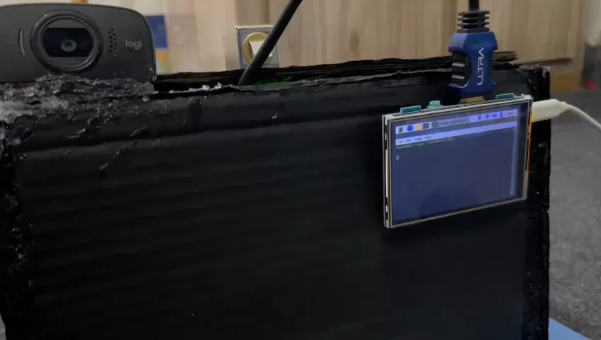
Project Demo
Fig 10: Hardware Results

Slide 22
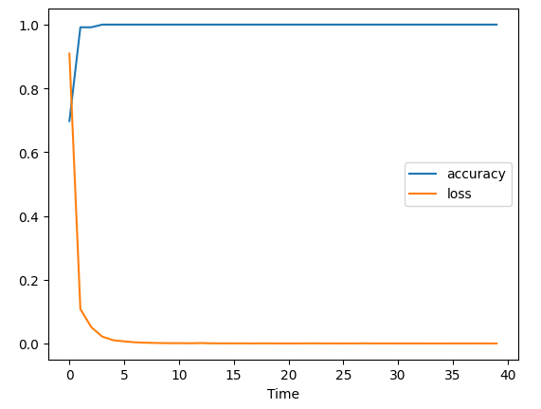
Accuracy loss Graph
Fig 11: Accuracy loss Graph

Slide 23
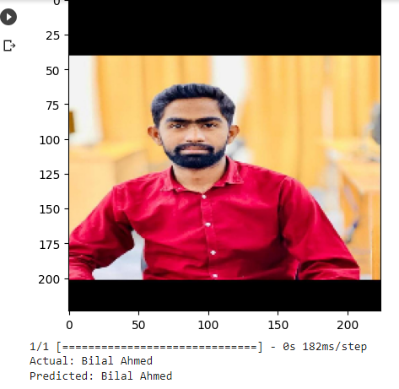
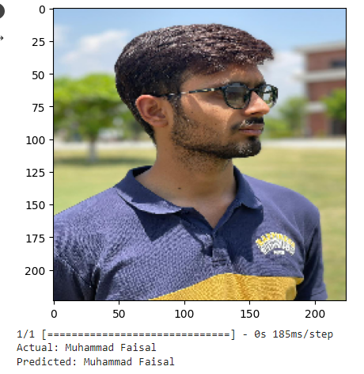
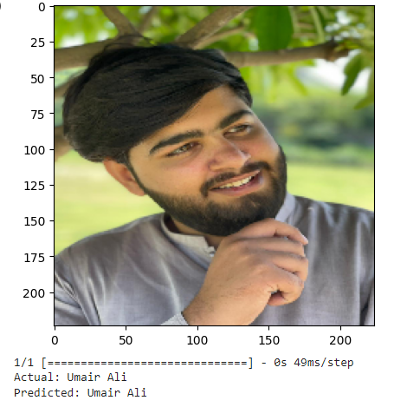
Software Results
Fig 12: Software Results

Slide 24
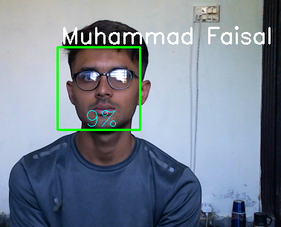
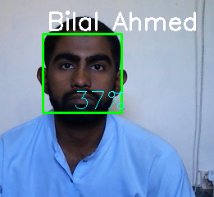
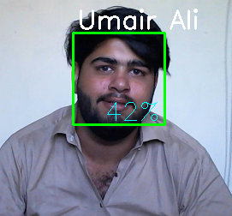
Hardware Results
Fig 13: Hardware Results

Slide 25
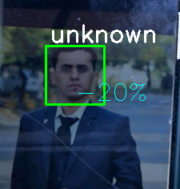
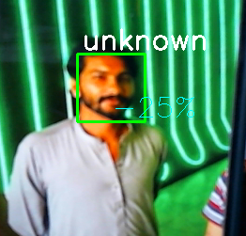
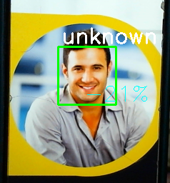
Hardware Results
Fig 14: Hardware Results

Slide 26
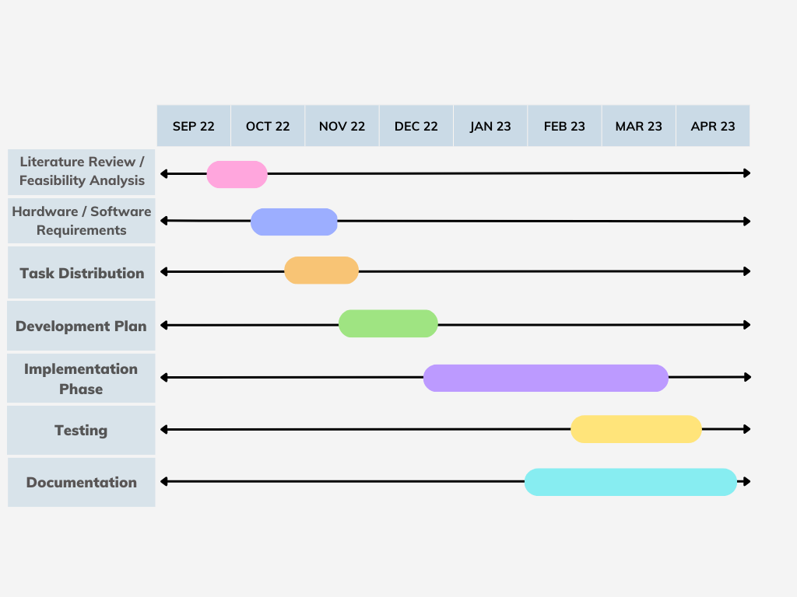
Work Plan (Gantt Chart)
JUNE 23
100%
100%
100%
100%
100%
100%
100%
Fig 15: Gantt Chart

Slide 27
Conclusion
The Facial Recognition Attendance System with Door Lock is an innovative and effective way to automate attendance and provide access control to a restricted area.
The system uses facial recognition technology to ensure that only authorized individuals can enter the area.
The system is easy to implement and offers a more secure and efficient solution compared to traditional attendance and access control systems.

Slide 28
References
[1] | Rovai, M. (n.d.). Real Time Face Recognition. [Accessed 1 10 2018].
[2] | Li et al, "IEEE Exlore," ICALT, 9 7 2020. [Online]. [Accessed 5 10 2020].
[3] | Jain et al, "IEEE Explore," CSNT, 18 6 2016. Accessed 25 10 2021].
[4] | Alqurashi and Mahmoud, "IEEE Explore," ICOSST, 15 12 2019. [Online]. Accessed 5 10 2022].
[5] | Sawhney and Shreyak, Confluence, 10 1 2019. [Accessed 25 10 2022].

Slide 29

Project Linked with COGNITOJS Pvt.Ltd

Slide 30


